Slide 1

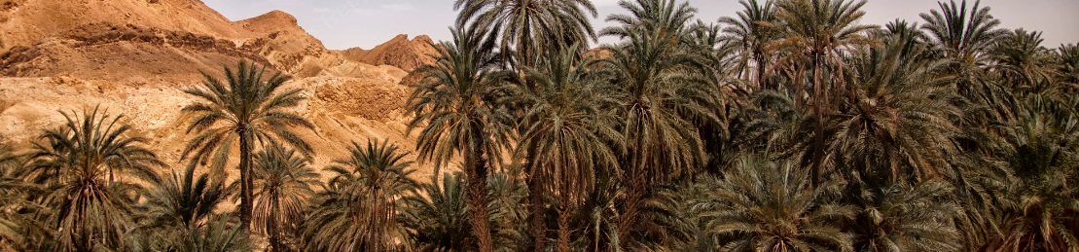
The Impact of the global warming in
the south of Tunisia by the end of
2030

Slide 2
Table of Contents
01
02
03
04
Introduction
Data Preprocessing
Modeling And Predicting
Results and Analysis

Slide 3

01
Introduction

Slide 4
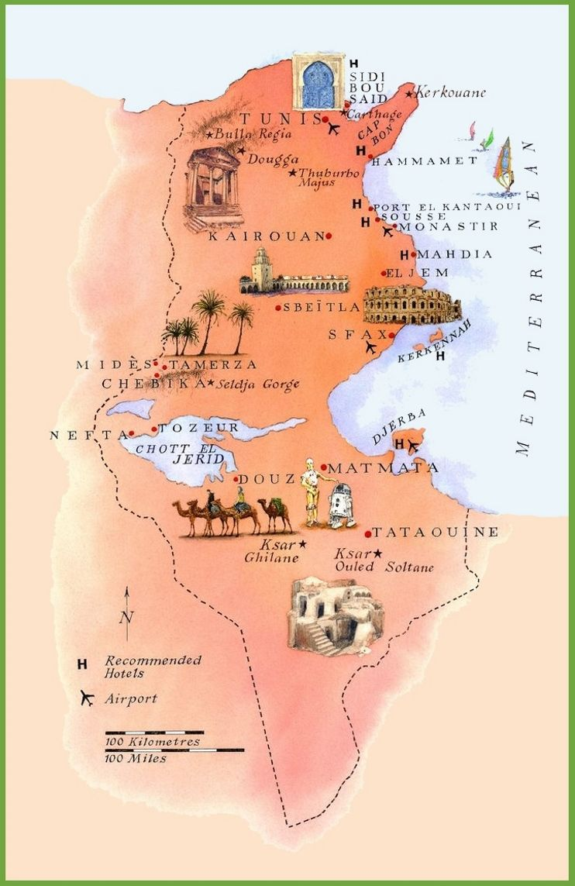
Chott el Djerid
Covers the width of southern Tunisia
Area of 5,360 km2
Chaotic climate difficult to predict

Slide 5
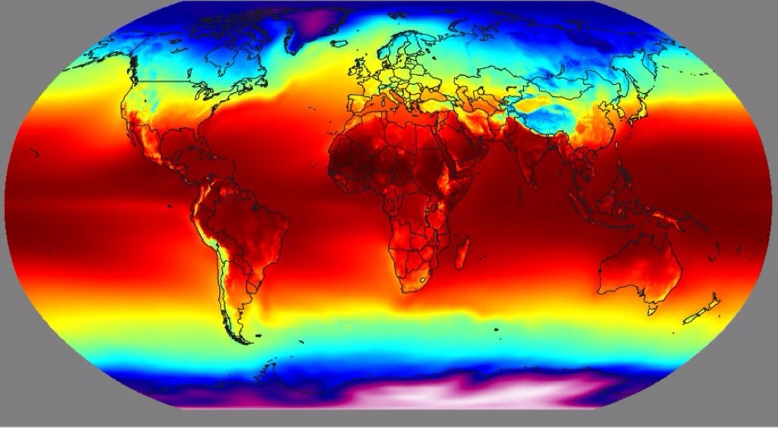
ERA5 reanalysis:
Simulation Data
Measurement
Observation
Temperature for a radius of 32km
Reliable data and good reputation among researchers
Data from 1990 to 2020 (30 years for free)

Slide 6

02
DATA PREPROCESSING

Slide 7
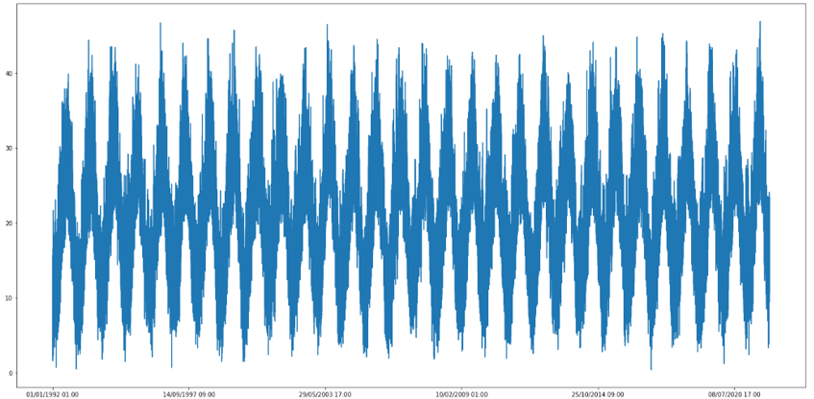
Exploratory Data Analysis
1/ Data Visualisation
Notes:
Comme on peut le remarquer, aucune conclusion ne peut être tirée. Ceci est attendu compte tenu de la forte variation de nos paramètres entre la nuit et le jour. Pour y remédier, nous décomposons les données. Pour la température nous prendrons deux valeurs, celle de maximum et de minimum hebdomadaire. Le choix des valeurs hebdomadaires est choisi pour réduire les fluctuations de température et harmoniser les valeurs de rayonnement qui varient beaucoup.

Slide 8
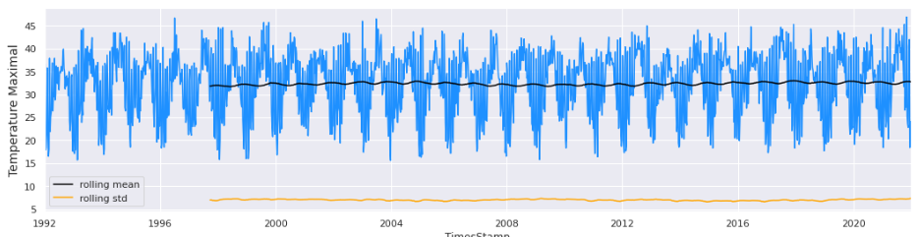
Exploratory Data Analysis

Slide 9
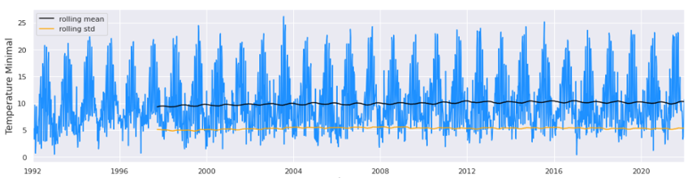
Exploratory Data Analysis

Slide 10
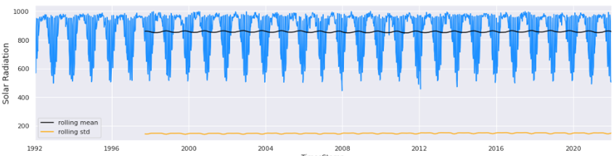
Exploratory Data Analysis

Slide 11

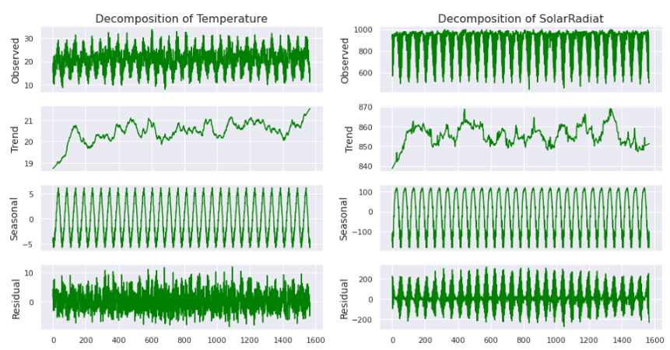
Exploratory Data Analysis
2/ Time Series Decomposition
Notes:
La décomposition des séries chronologiques consiste à considérer une série comme une combinaison de niveaux, de tendances, la saisonnalité et les composantes du bruit.

Slide 12
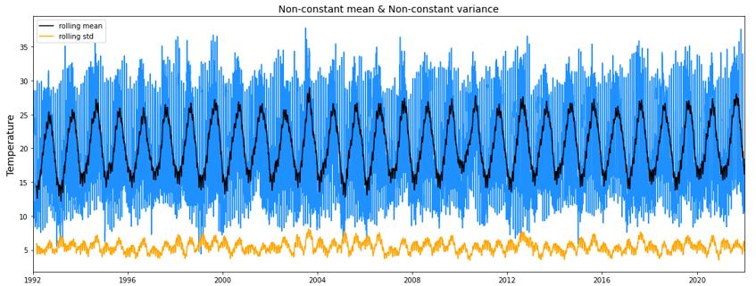

Exploratory Data Analysis
3/ Data Stationarity
Notes:
La stationnarité décrit que la série chronologique a :
- La moyenne constante et la moyenne ne dépendent pas du temps
- La variance constante et la variance ne dépendent pas du temps
Nous allons vérifier si nos données sont stationnaires ou non

Slide 13

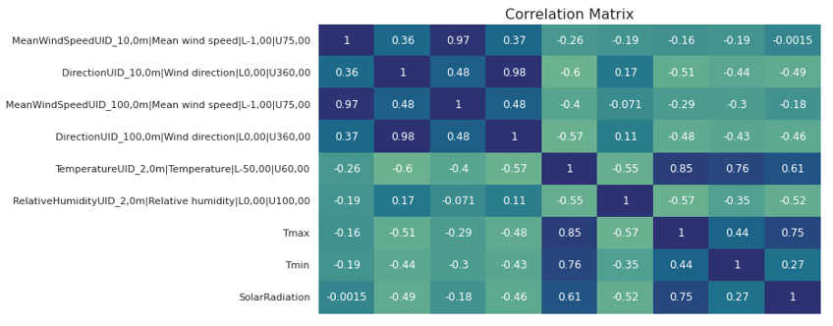
Matrix of Correlation

Slide 14
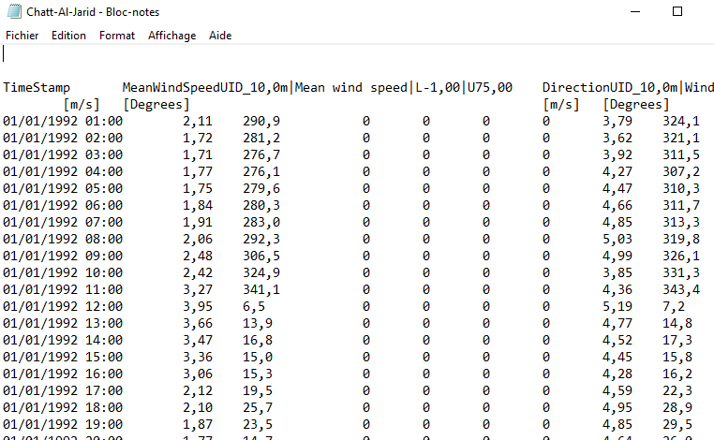
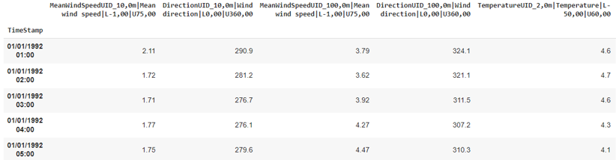
Data Cleaning
Notes:
Les flottants sont séparés par des virgule et non pas des simples points et donc les variables avait comme type object
Beaucoup de variables avait comme valeur ( NaN ou 0 ) c’est pour ce cela nous avons été obligé de les supprimer

Slide 15



03
Modeling and Predicting
Notes:
Now moving on to the modelling part of the problem

Slide 16
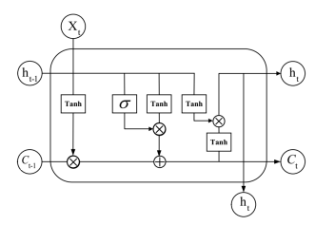
LSTM Model
Modelling sequential data
Storing sequences’ information for a longer time
Non-stationary time series forecasting
Notes:
First thing we need to talk about the core of our model which is the LSTM or Long Short-Term Memory layer, it has been a state of the art in terms of modelling sequential data and particularly Language Modelling before becoming used also with time series.
It’s advantage over other sequential data models is that it could memorize patterns from a long period in the past. In addition, it could deal with non-stationarity unlike other statistical models for time series such as ARIMA.

Slide 17
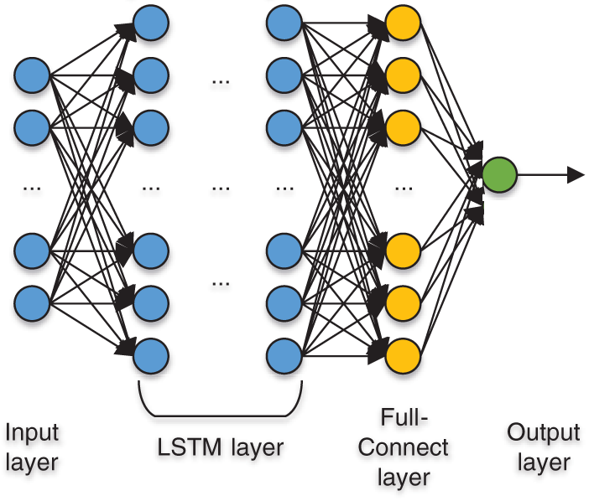
LSTM-Based Architecture
3 stacked LSTM layers to learn complex patterns
Fully-connected layers for output estimation
Batch normalization layers for numerical stability
Dropout layers to avoid over-fitting
Notes:
Now for our architecture, we have used 3 LSTM layers to learn complex patterns in the sequences, 2 fully connected layers to estimate the output, batch normalization layers for numerical stability and dropout layers to avoid overfitting the data

Slide 18

Our Approaches
Sequence of
datapoints
01
First Approach
Prediction of the following datapoint
Sequence-to-Value
Small error on validation set
Inability to forecast due to propagation of errors
02
Notes:
Our experimentation was composed of 2 approaches ; the first using the model as a sequence to value model where we take a sequence of past datapoints and predict the following value which will be concatenated to the sequence to predict the next point and so on and so fourth. This approach gave good results on the validation set but it was unable to do forecasting due to the propagation of the errors.

Slide 19

Our Approaches
Sequence of
datapoints
Prediction of the following
datapoints
01
Second Approach
Reasonable forecasting results
Ability to forecast a long period of time
02
Sequence-to-Sequence
Notes:
The difference in our 2nd approach is that we’re predicting a sequence of the following n_forecast points which made the process more robust and gave reasonable results as we’re going to see with Ahmed.

Slide 20
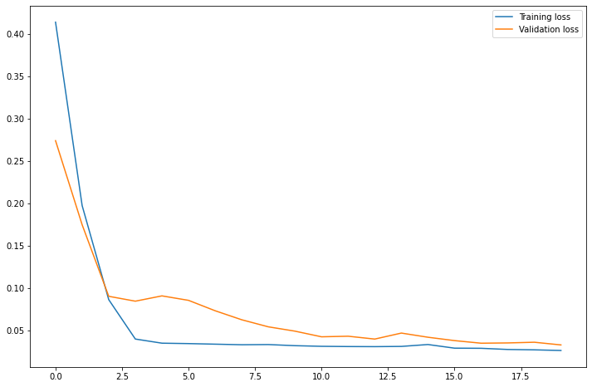
Model’s Evaluation
Evolution of training on the minimal temperature
Metric :
Mean Squared Error
Notes:
Now to evaluate the model while training we have plotted its training and the validation errors, for our first model that trained on the minimal temperature, we see the error stabilizes at around 5%,

Slide 21
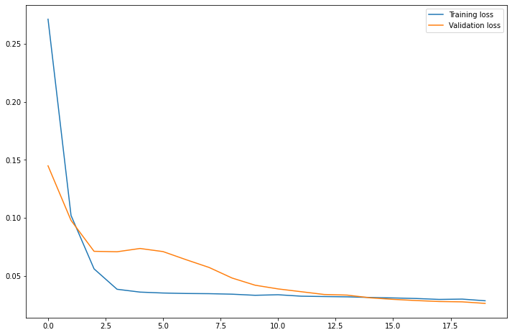
Model’s Evaluation
Evolution of training on the maximal temperature
Metric :
Mean Squared Error
Notes:
for the second model that trained on the maximal temperature, we see the error stabilizes at around 3% as well,

Slide 22
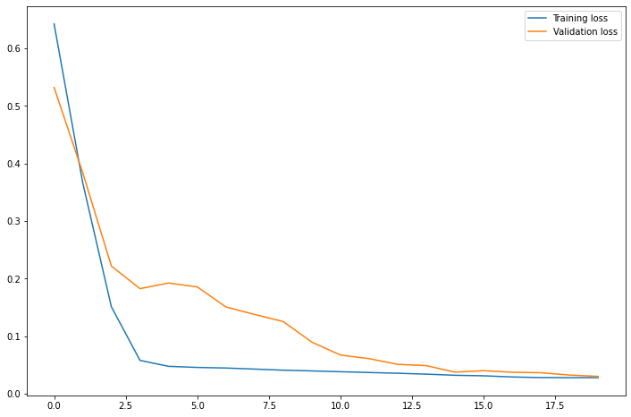
Model’s Evaluation
Evolution of training on the solar radiation
Metric :
Mean Squared Error
Notes:
And for our the final model that trained on the solar radiation, we see the error stabilizes at around 6%,

Slide 23
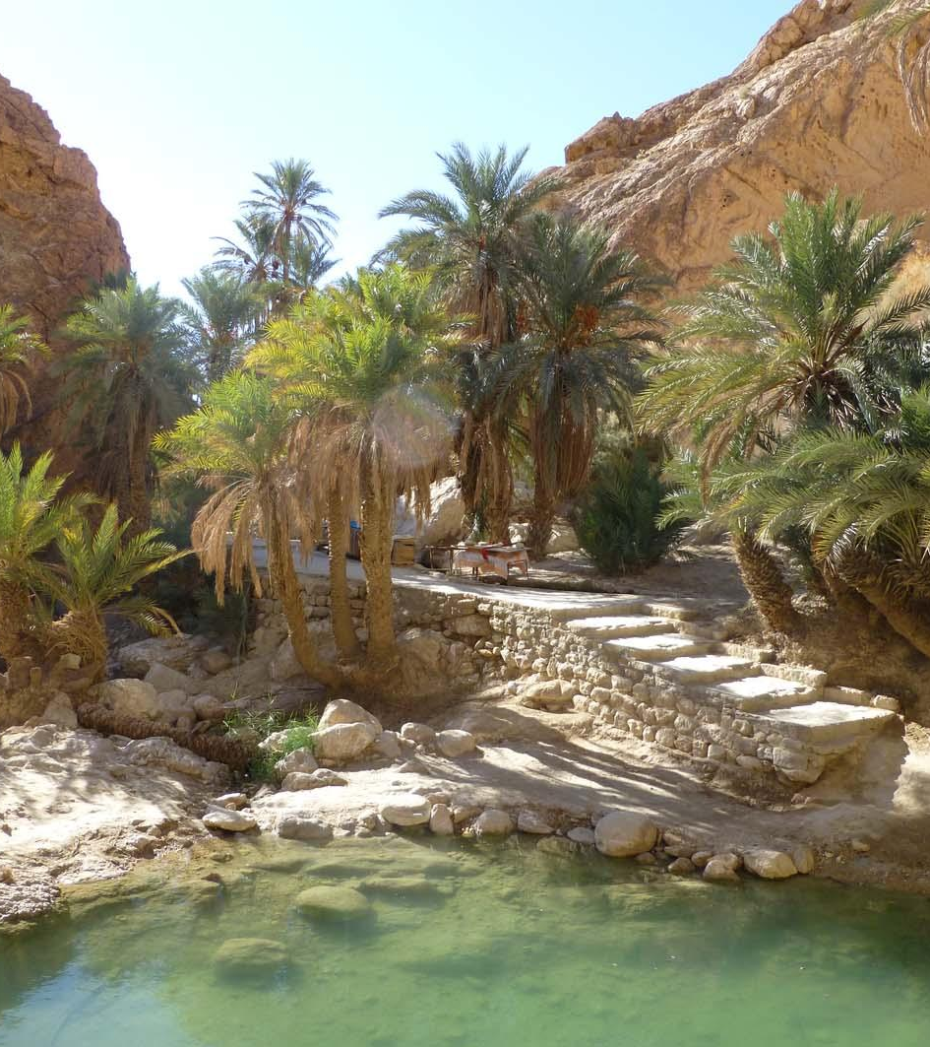
04
Results and Analysis

Slide 24
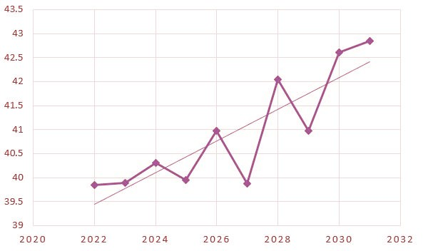
Maximum Temperatures

Slide 25
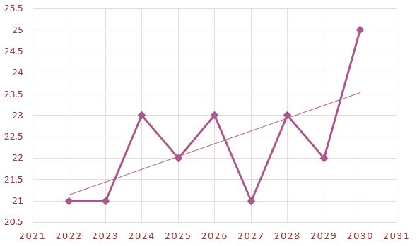
Number of days with temperatures >35°C

Slide 26
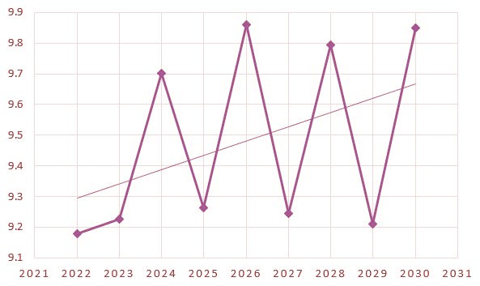
Minimum Temperatures

Slide 27
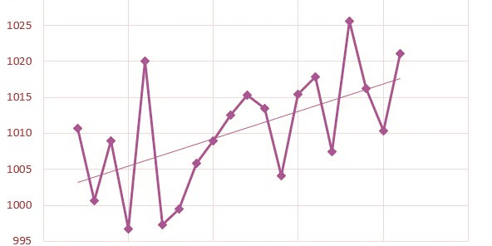
Solar Radiation

Slide 28

Health Concerns
Heart and respiratory system problems
Spread of disease carrying insects

Slide 29
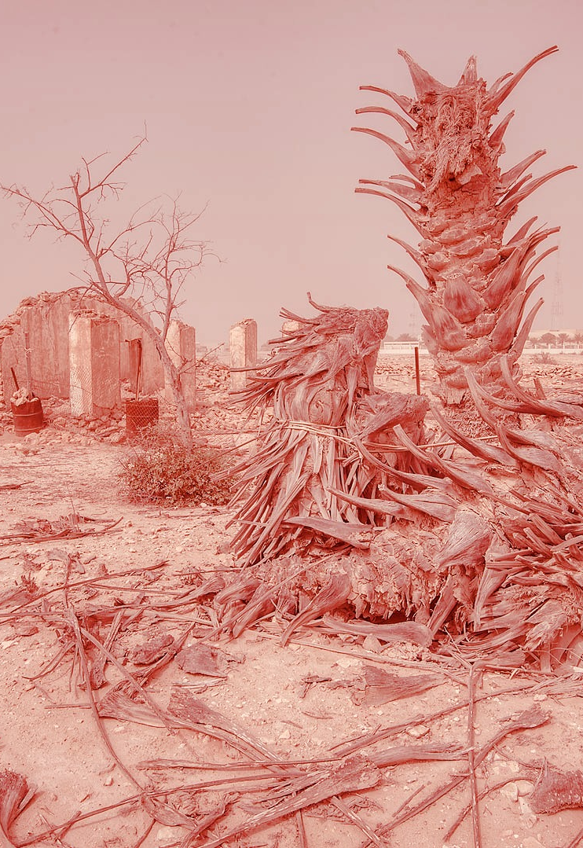
The Environment
Damage to the Flora
Indirect Devastation of the Fauna

Slide 30

Agriculture
1.6 million palm tree
4500 Camels
950 thousand trees of “deglat”

Slide 31

Agriculture
1740 Head of cattle
65000 Head of sheep
32000 chicken
31000 Goat

Slide 32
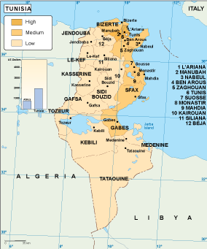
Social
Migration movement
Reduced social encounters

Slide 33

Energy generation and consumption
Dramatic increase in energy consumption
Light at the end of the tunnel (the center of the solar system)

Slide 34
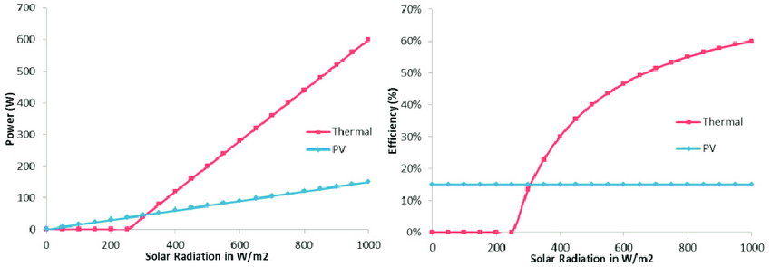
Solar power
Rising solar radiation the biggest opportunity

Slide 35
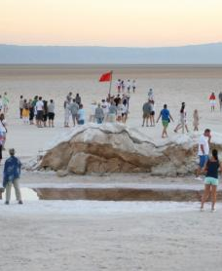
Tourism
Reduced number of visitors
Increased cost per visitor
Reduced activity due to low profit

Slide 36
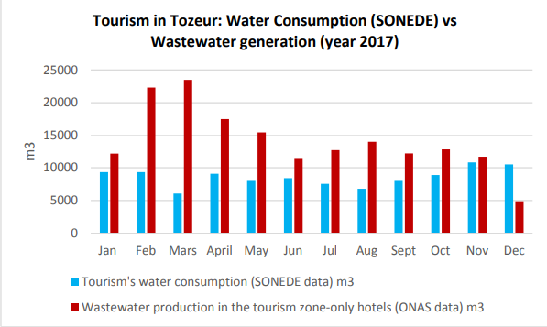
Water Consumption by tourism sector

Slide 37
Recommendations
Making Palm trees agriculture more profitable
Protecting the Soil
Better usage of Water resources
To save as many trees as possible
To increase the number of trees
To reduce the damage on living creatures
Improving the efficiency of irrigation system
Establishing laws to protect the area
Promoting natural tourism
To further spread trees and save water
To protect oases from overuse
To further establish the culture of protecting the environment

Slide 38

Conclusion

Slide 39
Thanks

Slide 40

Student Outcomes :
SO1, SO2, SO6: Well developed during the presentation
SO7:
Working on this project leads us to to acquire and apply new knowledge:
Data cleaning
Time series modeling and forecasting
Model evaluation
Bibliographic study-Research methodology

